Slide 1
Introduction to database
Prepared by Ela mannai

Slide 2
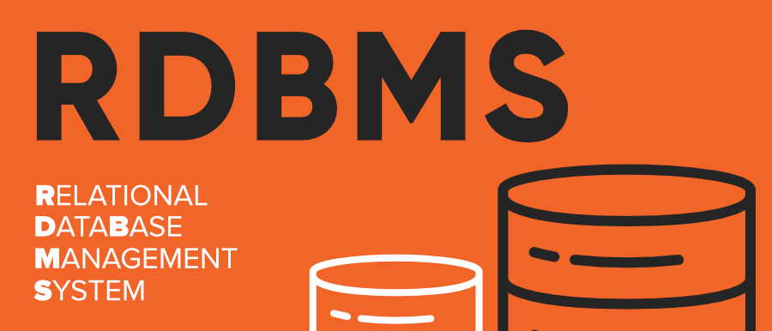
What is RDBMS
(RDBMS) is a collection of programs and capabilities that enable IT teams and others to create, update, administer and otherwise interact with a relational database. RDBMSes store data in the form of tables, with most commercial relational database management systems using Structured Query Language (SQL) to access the database

Slide 3
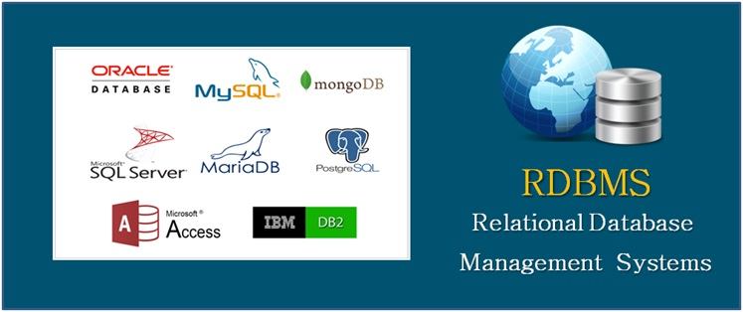
What are RDBMS relational ?
All modern database management systems like MySQL, PostgreSQL and SQL SERVER ., and Microsoft Access are based on RDBMS.

Slide 4

What is SQL Server ?
SQL stands for Structured Query Language. SQL is used to communicate with a database. According to ANSI (American National Standards Institute), it is the standard language for relational database management systems. SQL statements are used to perform tasks such as update data on a database, or retrieve data from a database. Some common relational database management systems that use SQL are: Oracle, Sybase, Microsoft SQL Server, Access, Ingres, etc.

Slide 5
What is MySql ?
MySQL is a relational database management system (RDBMS) developed by Oracle that is based on structured query language (SQL).
A database is a structured collection of data. It may be anything from a simple shopping list to a picture gallery or a place to hold the vast amounts of information in a corporate network. In particular, a relational database is a digital store collecting data and organizing it according to the relational model.

Slide 6
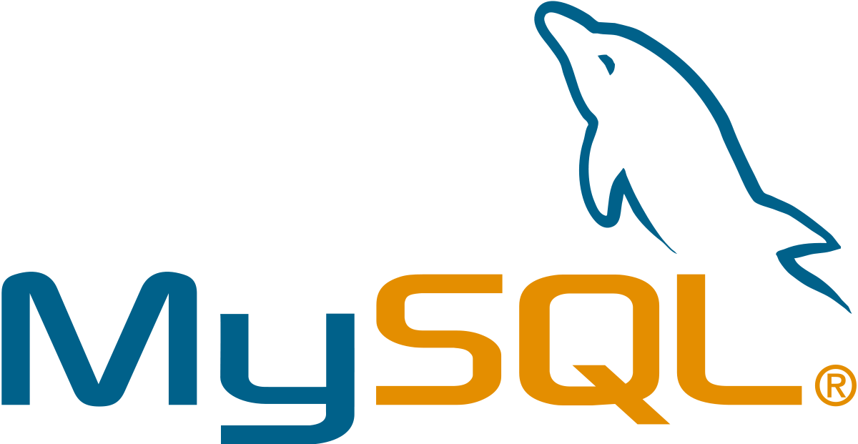
What is MySql ?
In this model, tables consist of rows and columns, and relationships between data elements all follow a strict logical structure. An RDBMS is simply the set of software tools used to actually implement, manage, and query such a database.

Slide 7
What is PostgreSQL ?
PostgreSQL is an advanced, enterprise class open source relational database that supports both SQL (relational) and JSON (non-relational) querying. It is a highly stable database management system, backed by more than 20 years of community development which has contributed to its high levels of resilience, integrity, and correctness. PostgreSQL is used as the primary data store or data warehouse for many web, mobile, geospatial, and analytics applications. The latest major version is PostgreSQL 12.

Slide 8

Advantages of using PostgreSQL ?
Rich features and extensions
Reliability and standards compliance,Open source license,Powerful features
The ease of handling transactions
“Code comments”
Parameters
Extensibility
Security
“Rich” SQL
Flexibility
Performance
Popularity
Support

Slide 9
Disadvantages of using PostgreSQL ?
The lack of data compression
Analytics-related limitations
Performance-related limitations
Administration-related challenges

Slide 10
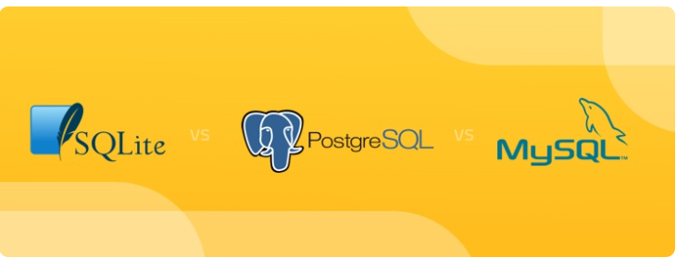
SQLite vs MySQL vs PostgreSQL: A Comparison Of Relational Database Management Syste
In this slide, we compare three of the most popular open-source RDBMS on the market. The comparison delves into differences in architecture, business continuity, use cases, and support that help you make an informed decision while pursuing database systems for your application.

Slide 11
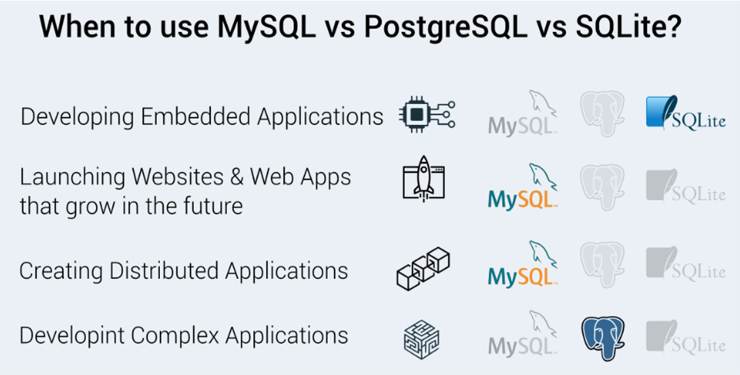
SQLite vs MySQL vs PostgreSQL: A Comparison Of Relational Database Management Syste

Slide 12
Thanks for your attention

